Slide 1
Notes:
Operational efficiency is a key goal in the world of cloud platforms, but how you get there is your choice.
The Pivotal Network and Pivotal Cloud Foundry Operations Manager provide customers with cosy browser interfaces for deploying and upgrading robust distributed systems without you ever getting your hands really dirty. But where's the catch?
With major releases of Pivotal Cloud Foundry scheduled every quarter and the spectre of critical vulnerability lurking around every corner, your business depends upon a reliable and repeatable strategy for repaving all your instances with confidence and speed. The words "mouse" or "keyboard" should not feature in your solution, but where does that leave us with the Operations Manager?
In this session, Alan will discuss his experiences with the Operations Manager and how a chance encounter with the Ops Manager API led to some deep dives and a new way of thinking about CI/CD in the platform space.

Slide 2
Fire Exit Announcement - You know the “drill” ☺
Please note the locations of the surrounding emergency exits & located the nearest lit EXIT sign to you
In the event of a fire alarm or other emergency, please calmly exit to the public concourse area
Emergency exit stairwells leading to the outside of this facility are located along the public concourse
For your safety in an emergency, please follow the directions of the Public Safety Staff

Slide 3
Platform Automation The Pivotal Way: or How I Learned To Stop Typing And Love The Operations Manager
Alan McGinlay
Principal Technical Instructor, Pivotal
Notes:
Hello Boston and thank you all so much for indulging me today.
It’s my first time in the city for 22 years and it’s great to be back.
Let’s get started
-------------------------------------------------------------------------------------------------------------
Demonstrate https://YOUR_OPSMAN/api/v0/installations GET request via the Ops Manager front end
Demonstrate https://YOUR_OPSMAN/api/v0/staged/director/properties GET request via the Ops Manager front end

Slide 4
TL;DR
https://github.com/amcginlay/ops-manager-automation
Notes:
- If you want to zone out and catch this on repeat, at least take a look here

Slide 5
Introduction – Who Am I?
Alan McGinlay
Email: amcginlay@pivotal.io
Twitter: @amcginlay
LinkedIn: amcginlay
Principal Technical Instructor at Pivotal
Primary contributor to PCF Admin course on GCP
10 year old hacker with 22 years industry experience
All things Cloud Native
“Use a little bit of whatever makes it work”
Notes:
PCF Admin -> PCF Operator

Slide 6
Introduction – Who Are You?
Existing or potential Pivotal customers
Organisations deploying Cloud Native platforms at scale
Operations staff (“rockstars”)
Automation freaks
Nervously curious types
Fellow educators
Friends
Colleagues

Slide 7
Why Are We Here?
We want to:
Achieve operational efficiency and developer productivity
Make actions reliably repeatable and eliminate toil
Embrace the Command Line Interface
Leverage CI/CD technologies
Attract and retain top talent
Get a life!
Notes:
I hope some of these bullet points resonate with you
------------------------------------------------------------------------------------------------------------
I really wanted to bridge the gap between staying manual and dipping your toes into platform automation – let’s lower the bar.
The 12-factor guidelines are divided between (a) Software Developers and (b) the Self-Service Platforms they use (after all, no-one ever developed a 6-factor “Cloud Native” app)
As an instructor, existing solutions are a little too “opaque” to be used as educational tools.
Perhaps my version of vanilla doesn’t taste like yours.
Perhaps I don’t have the time to learn new development languages.
“One size fits no-one” – maybe I’m part of the problem?!?!?!

Slide 8
Educational Deployment Use Cases
As instructors we encounter two main deployment use cases:
Publication of step-by-step instructions for teaching operators how to pave new instances.
Pre-building multiple, identical instances for teaching developers how to use the platform.
Notes:
1. Operators - When we do this manually, the student finds it error prone.
2. Developers - When we do this manually, the instructor finds it boring.
Automation can help, but if we make this a binary choice (everything manual vs. everything automated) , it’s not a good educational tool. Students want to observe cause and effect at the right level of granualarity
I wanted to make use of automation to help both instructor and students
This work is helping inform some of our future direction w.r.t. initial customer engagements.
I’m hoping there may be something in here for you you too.

Slide 9
Introduction – catch()
We’ll be touching upon the following topics:
The Ops Manager UI on GCP
The Om and PivNet CLI tools
The Ops Manager and PivNet APIs
A few BASH scripts

Slide 10
Introduction – throw()
We’ll be swerving the following topics:
Platform upgrades ¹
BOSH ²
Concourse
AWS, Azure, OpenStack, vSphere, etc.
¹ https://github.com/pivotal-cf/pcf-pipelines
² http://ultimateguidetobosh.com/
Notes:
-----------------------------------------------------------------------------------------------------------
BOSH -> Ops Manager is an abstraction on BOSH, we’re heading in the other direction.
Concourse -> Yuri, Thesese and Ryan did a talk on Concourse platform automation yesterday that you may want to review

Slide 11
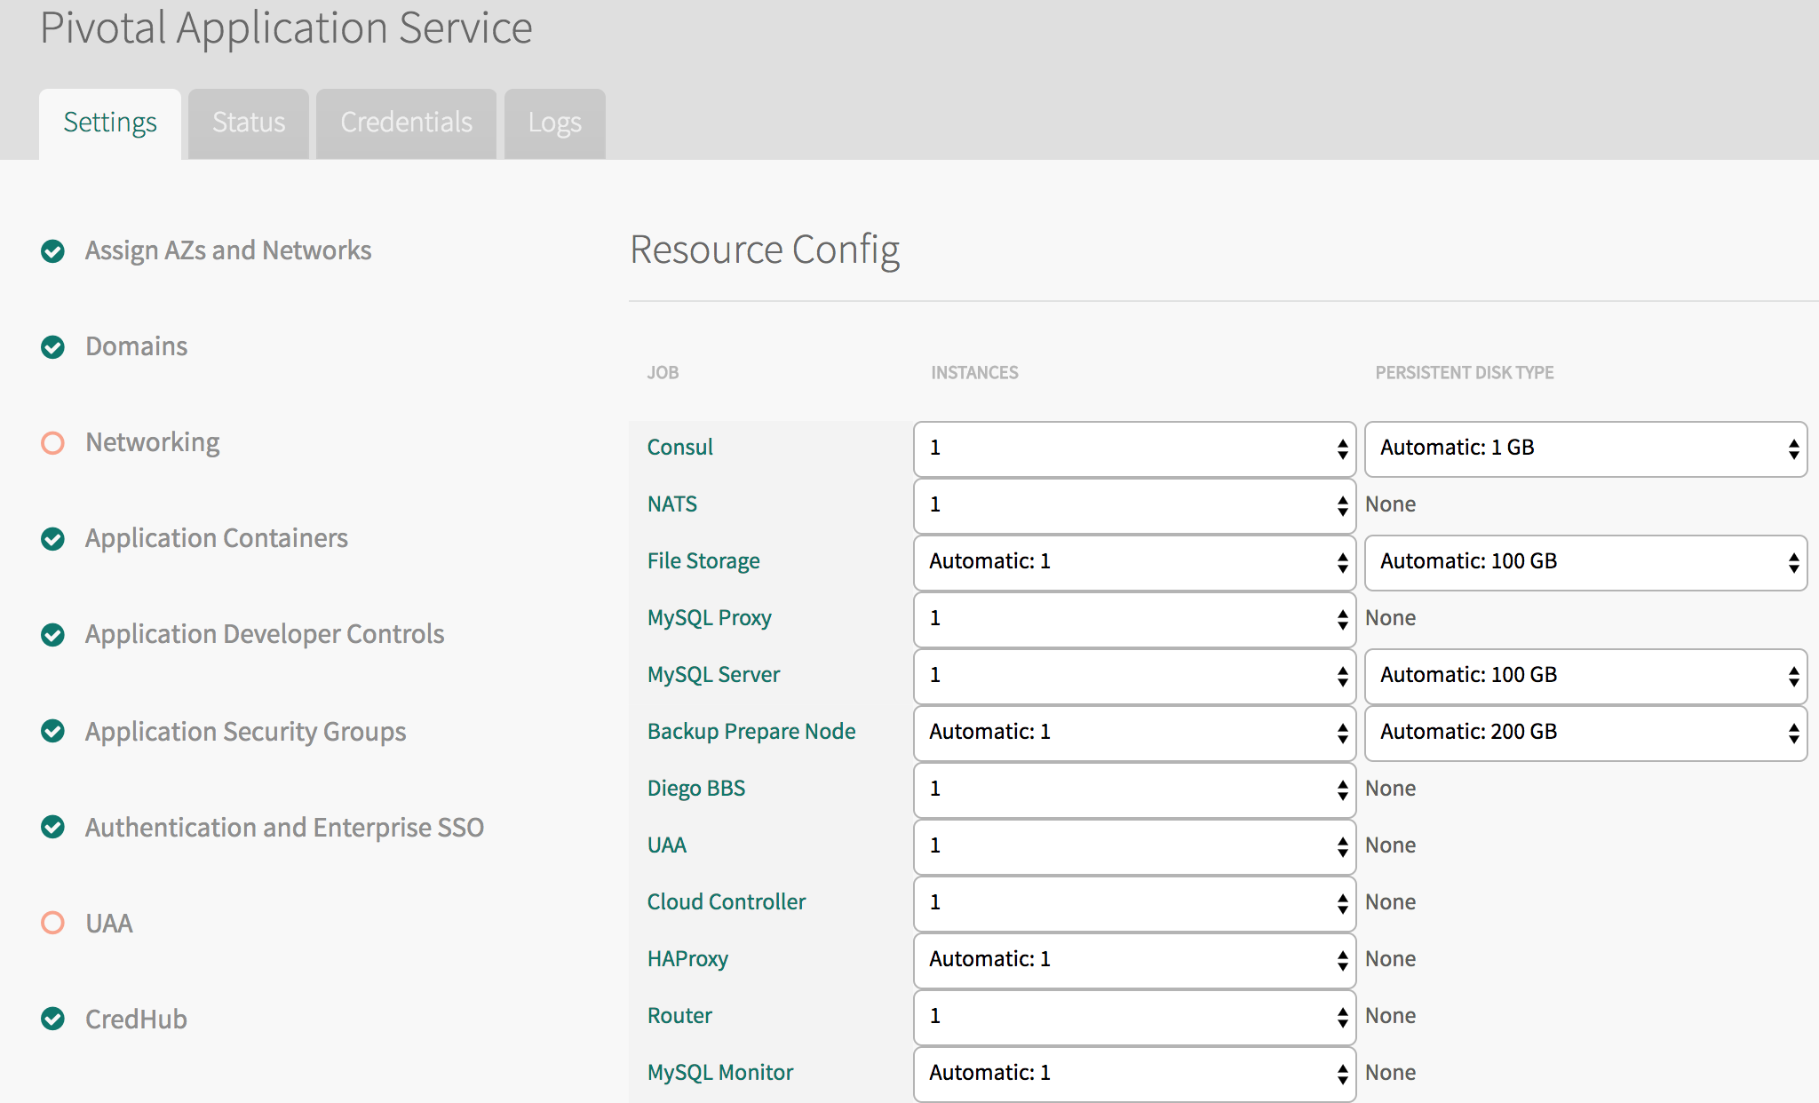
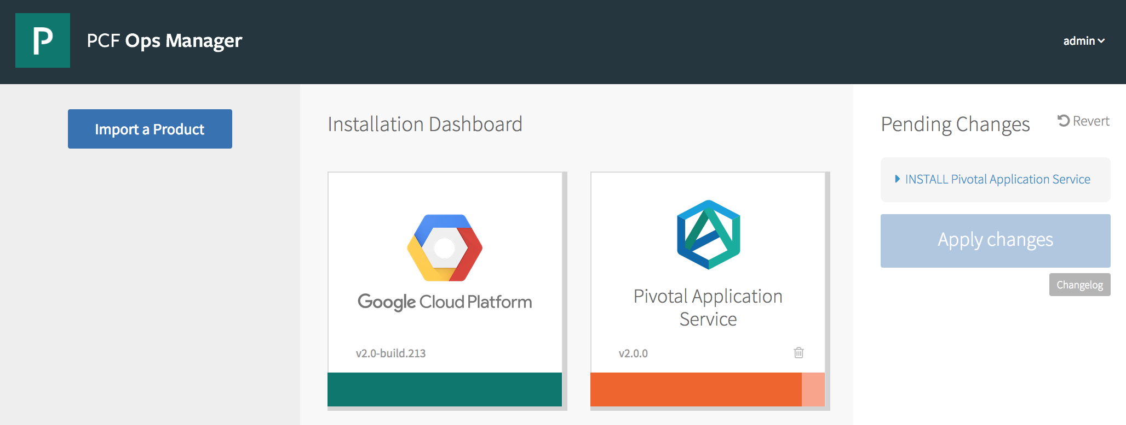
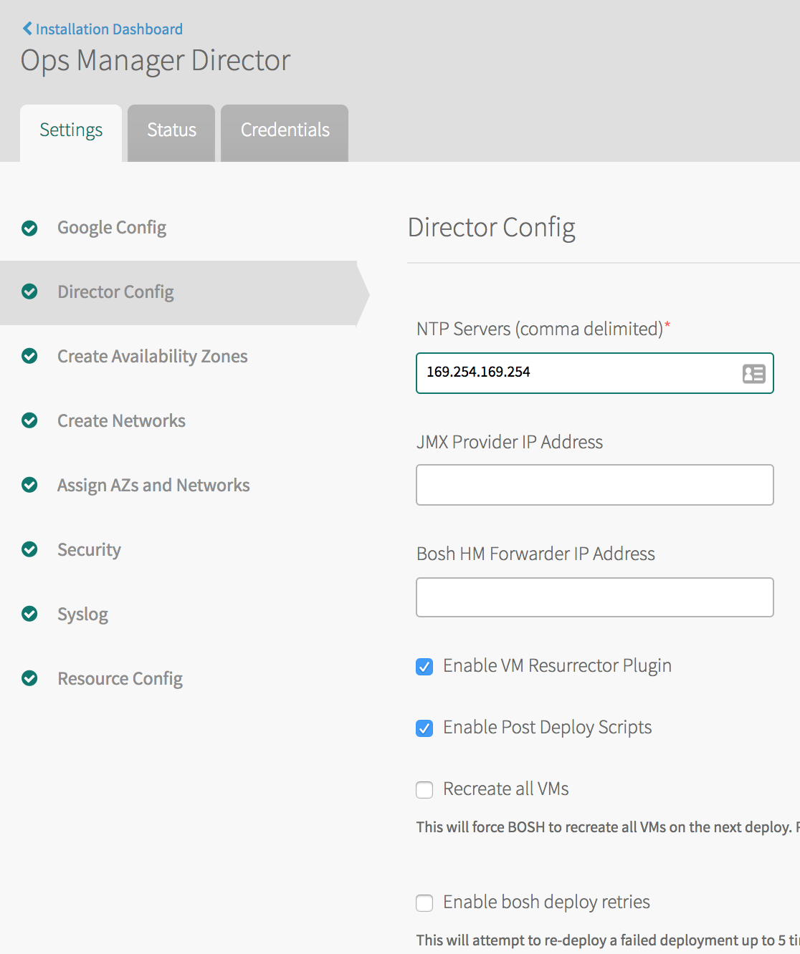
The Ops Manager
Notes:
Familiar view of the Ops Manager installation dashboard
Full control over configuration of tiles
Heavily Mouse and Keyboard based
Our Goal - turn ORANGE things GREEN !!!
------------------------------------------------------------------------------------------------------------

Slide 12

Why Use The Ops Manager? (1/2)
BOSH …
… is hard
Notes:
-------------------------------------------------------------------------------------------------------------
The Ops Manager isolates you from BOSH.
BOSH is all about distributed systems … and they’re really hard. Barriers to entry are very high. We could use a hand.
A typical BOSH manifest can be 1000’s of lines of YAML – I’m sorry, but YAML is like an ugly baby!
Complexity … leading to release paralysis perhaps?
BUT ISOLATION FROM BOSH IS NOT ENOUGH …

Slide 13
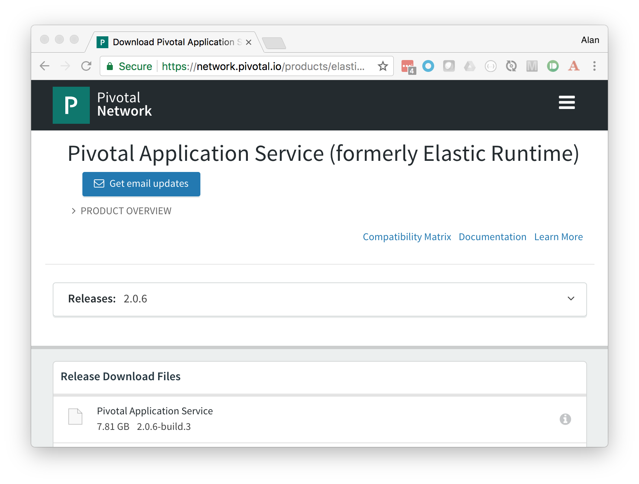
Why Use The Ops Manager? (2/2)
PivNet …
… is easy
and safe
Notes:
The OpsManager works in conjunction with The Pivotal Network
… AND THIS IS WHERE OPS MANAGER SHINES
PivNet is a one-stop shop for products as well as third-party offerings.
Shrink-wrapped BOSH deployments for easy consumption.
Customer license SLAs protect enterprises (“Pivotal attempts to respond to all critical vulnerabilities within 48 hours.”)
-------------------------------------------------------------------------------------------------------------

Slide 14
The Ops Manager – Alternate Viewpoints
The web interface makes configuration seem easy. It’s not.
Webpage form validation won’t catch everything.
“Fat fingers” frequently fail.
Operations staff often prefer using the command line.
“I’m sure it worked yesterday!”
Network bandwidth issues
“I’ve got FIFTY of these things!”
Notes:
But let’s be pragmatic about this, there are some concerns the come with all this niceness.
-------------------------------------------------------------------------------------------------------------
Sometimes it’s easier to blame the system than admit you messed it up.
We want to narrow the scope for error
Isn’t there a better way without losing the benefits?

Slide 15


Why Would You Do This?
PivNet
Downloads
Imports
OpsMan
Notes:
- In this typical configuration the BROWSER is our primary interface
- Bandwidth requirements HIGH ( I could be on an airplane!)
-------------------------------------------------------------------------------------------------------------
PivNet downloads can be up to 10GB in size
In summary, our reliance on GUI tools often holds us back

Slide 16

Shelling out
PivNet
Downloads
Jumpbox
Imports
OpsMan
Notes:
- In this configuration the JUMPBOX is our primary interface via SSH
Bandwidth requirements LOW
-------------------------------------------------------------------------------------------------------------
The jumpbox could be a Windows box, but it’s typically headless Ubuntu
BUT OUR COMFORT BLANKET IS GONE

Slide 17
API Abstractions (CF_TRACE)
> cf domains
Getting domains in org amcginlay as admin...
name status type
apps.amcginlay.gcp.pivotaledu.io shared
> CF_TRACE=true cf domains
Getting domains in org amcginlay as admin...
REQUEST: [2018-04-12T11:18:30+01:00]
GET /v2/organizations/677a283b-933d-43b3-8130-2541d14e8117/private_domains HTTP/1.1
...
RESPONSE: [2018-04-12T11:18:31+01:00]
HTTP/1.1 200 OK
...
{ JSON }
Notes:
- We can consider Applications as abstractions that help us get our work done
Similarly, APIs are the abstractions that helps those application get their work done (chain of command, onion ring architecture, there are layers to this)
Sometimes we need to uncover the API to reveal new approaches to problem solving which the applications cannot address.
--------------------------------------------------------------------------------------------------------------
Injecting CF_TRACE allows me to see which Cloud Controller APIs are being called.
The cf CLI is an example of command line tool which abstracts an API.
The Apps Manager (if you’re familiar with it) uses the exact same API
It turns out that the Ops Manager is another example of an abstraction over an API

Slide 18
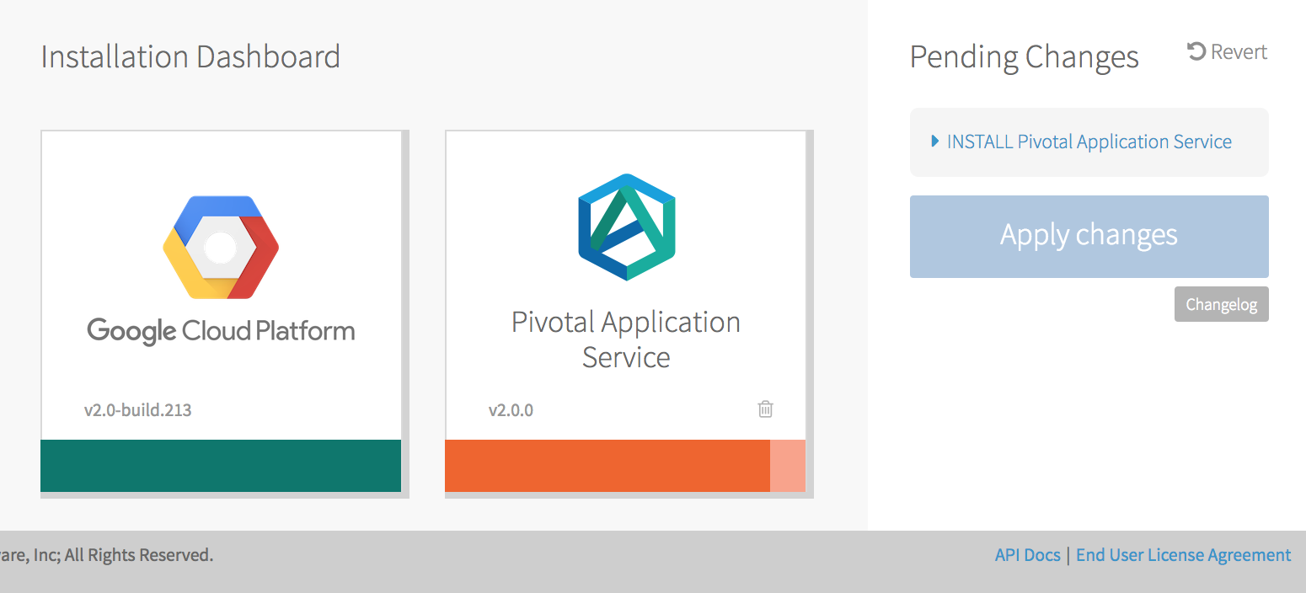
No More Pointy-Clicky (1 of 2)
Notes:
--------------------------------------------------------------------------------------------------------------
- THIS is not the path to operational efficiency

Slide 19
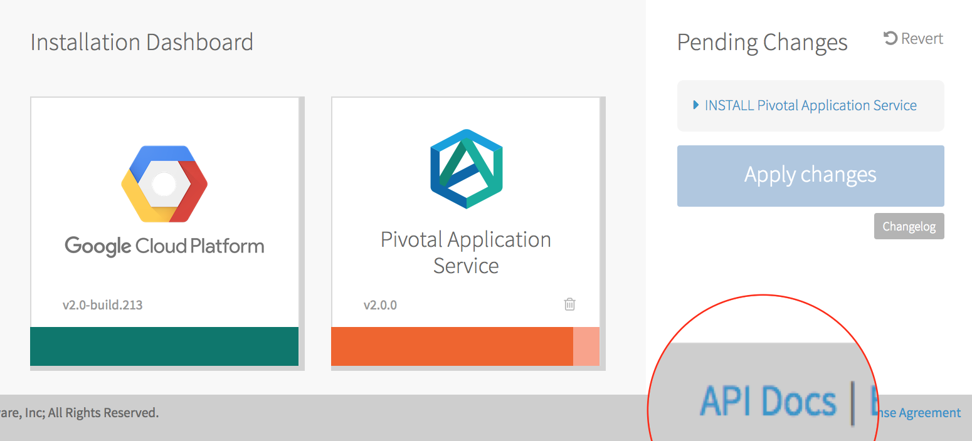

No More Pointy-Clicky (2 of 2)
Looks like you don’t actually wanna go home tonight.
Should I order pizza?
Notes:
--------------------------------------------------------------------------------------------------------------
API Docs link will take you down a rabbit hole
This will take some time but it’s worth the investment
DON’T RUSH INTO THE NEXT SLIDE … (preamble)

Slide 20
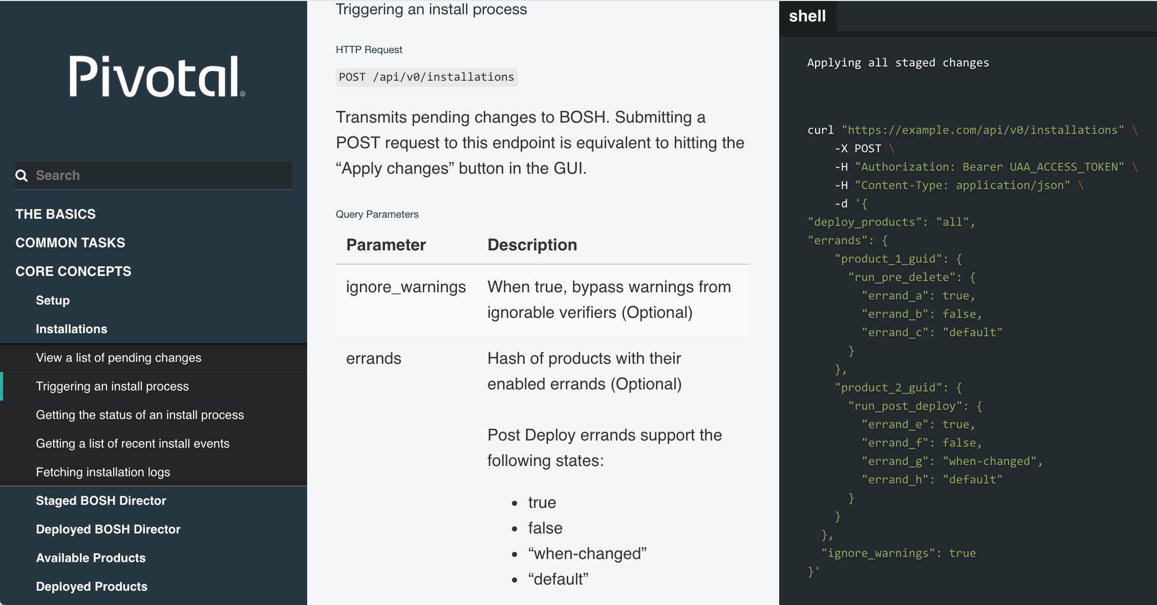
The Ops Manager API (/docs)
Notes:
- Historically, APIs weren’t built around standard wire protocols. We used statically linked libraries, often using exotic data-types which made them difficult to consume.
Loosely coupled REST APIs built on HTTP help, but the details can get scary. (e.g. headers, authentication, payloads, formatting). In the post-XML world we’re wholly dependent on good documentation
--------------------------------------------------------------------------------------------------------------
So here we are, down the rabbit hole, looking at the POST method at the /api/v0/installations endpoint which represents “Apply Changes”
If /api/v0/ seems familiar, you’re not wrong …

Slide 21
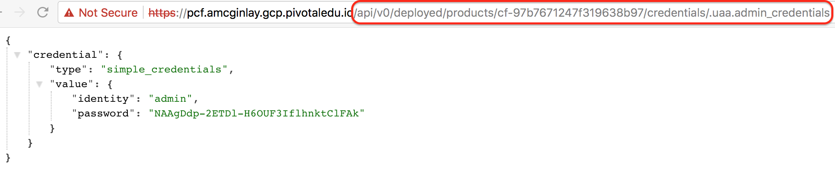
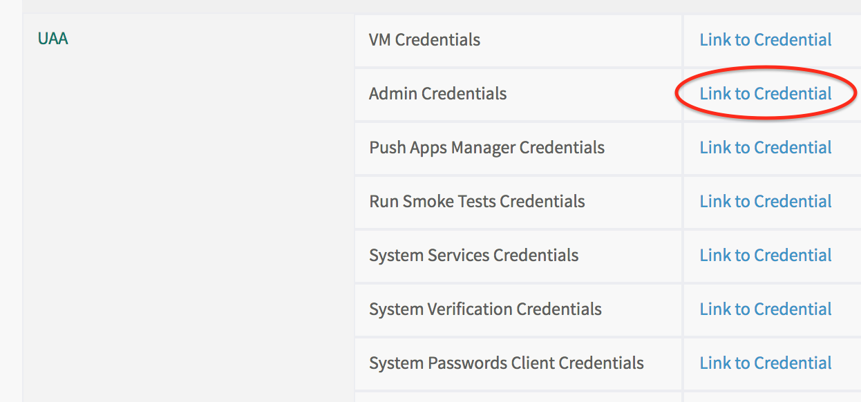
Déjà vu?
> cf login \
–a api.sys.amcginlay.gcp.pivotaledu.io \
–u admin
Notes:
Now hold on, we’ve seen this somewhere before?
Remember how you first extracted the CF CLI admin password from the Elastic Runtime (PAS) tile?
Occasionally Ops Manager says, “You’re cool, you know what you’re doing, so I’ll lift the lid for you”

Slide 22
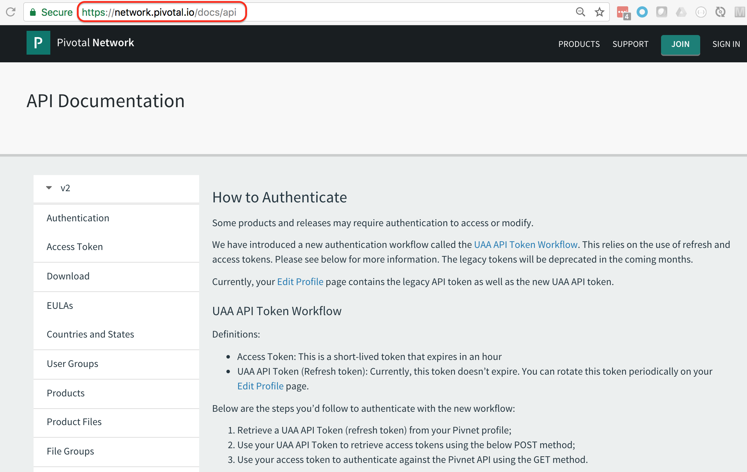
The Pivotal Network API (/docs/api)
Notes:
- The Ops Manager is not alone, PivNet’s got an API too … but more about that later …

Slide 23
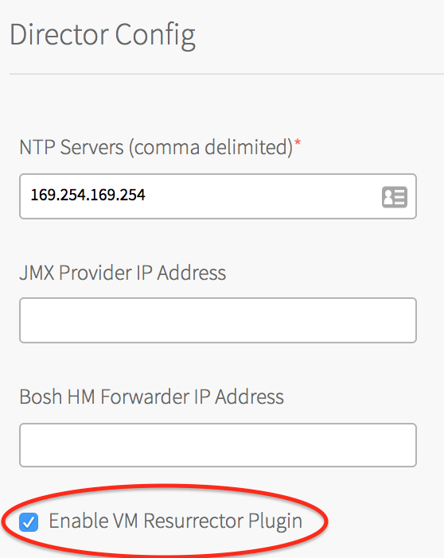
API GET requests via the browser (1 of 2)
The API documents the endpoints.
You can access GET method API requests via an authenticated browser session.
For example:
Navigate to https://YOUR_OPSMAN/api/v0/staged/director/properties
Find the resurrector_enabled entry in the resulting JSON.
The entry value should match the setting shown in the Ops Manager Director Config page.
Notes:
DIRECTOR
--------------------------------------------------------------------------------------------------------------
Two views onto the same information

Slide 24
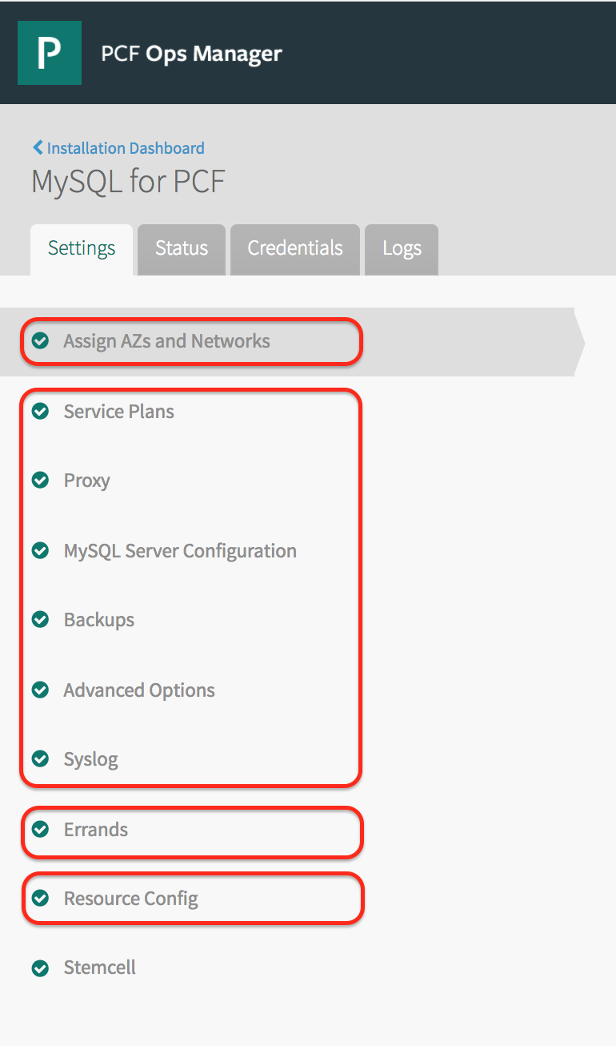
API GET requests via the browser (1 of 2)
Product config divides into four sub-parts, each with their own endpoints:
networks_and_azs .../api/v0/staged/products/<PRODUCT_GUID>/networks_and_azs
properties .../api/v0/staged/products/<PRODUCT_GUID>/properties
errands .../api/v0/staged/products/<PRODUCT_GUID>/errands
resources .../api/v0/staged/products/<PRODUCT_GUID>/resources
Notes:
PRODUCTS
--------------------------------------------------------------------------------------------------------------
Network config (isolate certain workloads)
Errands (one-off tasks like pushing Apps Manager and registering Service Broker)
Resource Config (VM configuration)
Properties (product specific)
So we can perform updates in the Ops Manager, but until now we’ve only seen the API doing authorized GETs in a browser. What about updates via the API … ?

Slide 25
Ops Manager - Curling over SSH
# AUTHENTICATE ADMIN USER AND EXTRACT ACCESS TOKEN
gem install cf-uaac
uaac target https://YOUR_OPSMAN/uaa --skip-ssl-validation
uaac token owner get opsman admin -s ""
TOKEN=$(uaac context | grep "access_token:" | tr -s ' ' | cut -d' ' -f3)
# VIEW ALL THE DIRECTOR PROPERTIES
curl -k "https://YOUR_OPSMAN/api/v0/staged/director/properties" \
-X GET -H "Authorization: Bearer ${TOKEN}”
# CHANGE ONE OF THE DIRECTOR PROPERTIES
curl -k "https://YOUR_OPSMAN/api/v0/staged/director/properties" \
-X PUT -H "Authorization: Bearer ${TOKEN}"
-d '{ "director_configuration": { "resurrector_enabled": false } }'
Notes:
Returning to the DIRECTOR to show one half of a set of CRUD operations -> a GET and PUT combination for a checkbox
--------------------------------------------------------------------------------------------------------------
We don’t need to send ALL the director_configuration, we just need the elements which contain modifications
BEFORE WE MOVE ON, note how much work is required to authenticate (logon to UAA to fetch the access token)

Slide 26
Pivotal Network - Curling over SSH
# SEARCH PIVNET FOR MYSQL
curl "https://network.pivotal.io/api/v2/products" | \
jq -r '.products[] | [.name, .slug] | @csv' | grep '"MySQL for PCF"'
# IDENTIFY LATEST DOWNLOAD LINK
curl "https://network.pivotal.io/api/v2/products/p-mysql/releases/latest" | \
jq -r '.product_files[] | select(.aws_object_key | endswith(".pivotal")) | ._links.download.href'
# ACCEPT EULA
curl --header "Authorization: Token ${PIVNET_TOKEN}” --request POST \
"https://network.pivotal.io/api/v2/products/p-mysql/releases/53812/eula_acceptance"
# DOWNLOAD PRODUCT
curl --header "Authorization: Token ${PIVNET_TOKEN}" --location --output ${TARGET_FILENAME} \
"https://network.pivotal.io/api/v2/products/p-mysql/releases/53812/product_files/87255/download"
Notes:
It’s a similar story when interacting with PivNet.
In this example, we replicate typical GUI workflow using the API
1. SEARCH
2. PICK LATEST
3. EULA
4. DOWNLOAD
--------------------------------------------------------------------------------------------------------------

Slide 27
A Better Curl (CLI tools)
PivNet CLI (https://github.com/pivotal-cf/pivnet-cli)
Automates Pivotal Network GUI
Interrogates Product Versions
Accepts EULAs
Downloads Products
Downloads Stemcellls
“Om” CLI (https://github.com/pivotal-cf/om)
Automates Ops Manager GUI
Configures Authentication
Configures BOSH Director Tile
Imports & Stages Products Tiles
Imports Stemcells
Configures Product Tiles
“Hits” Apply Changes
Notes:
That was rather painful, we’d rather use an abstraction
Shown here, from top to bottom, is a typical workflow, downloading from PivNet, uploading to Ops Manager, before being configured and finally deployed (equiv. Apply Changes)
--------------------------------------------------------------------------------------------------------------
The APIs work fine
But the CLIs are just easier to work with

Slide 28
Here’s One I Made Earlier
https://github.com/amcginlay/ops-manager-automation
(see README.md, ./scripts and ./config)
Notes:
I’ve done the hard work for you …

Slide 29
Environment Specific Variables (~/.env)
# Each task script sources ~/.env which exports these variables
PCF_VERSION_PATH=2.1
PCF_DOMAIN_NAME=mydomain.com
PCF_SUBDOMAIN_NAME=myenvironment
PCF_OPSMAN_ADMIN_USER=admin
PCF_OPSMAN_ADMIN_PASSWD=drowssaP_gnortS_emoS_42
PCF_REGION=europe-west1
PCF_AZ_1=europe-west1-b
PCF_AZ_2=europe-west1-c
PCF_AZ_3=europe-west1-d
PCF_PIVNET_API_TOKEN=RgJ6tSOMETHINGvxTssJ
Notes:
If we’re using APIs or, indeed, CLIs directly, we’d need to provide lots of contextual info on every call we make.
My scripts abstract this away into variables which capture the specifics of a single target environment
--------------------------------------------------------------------------------------------------------------

Slide 30
The Money Shot
# assuming we’re configured to point at a pristine Ops Manager
./scripts/configure-authentication.sh
./scripts/configure-director-gcp.sh
./scripts/mk-ssl-cert-key.sh
PRODUCT_SLUG="elastic-runtime" PRODUCT_VERSION="2.1.1" PRODUCT_FILE_ID="112577" \
./scripts/import-product.sh
IMPORTED_NAME="cf" IMPORTED_VERSION="2.1.1" ./scripts/stage-product.sh
IMPORTED_NAME="cf" ./scripts/configure-product.sh
./scripts/apply-changes.sh
Notes:
From empty Ops Manager to fully operational elastic runtime (PAS) in eight lines of BASH script
Remember our goal to keep these steps discrete. This gives us: a) the flexibility to tailor for your own requirements b) the ability to learn by seeing stepwise causality (each step represents a visual state-change in the Ops Manager – students don’t think it’s black magic)
We see this as an important instructional aid … and it keep us instructors sane too!
[point out the yellow variables]

Slide 31
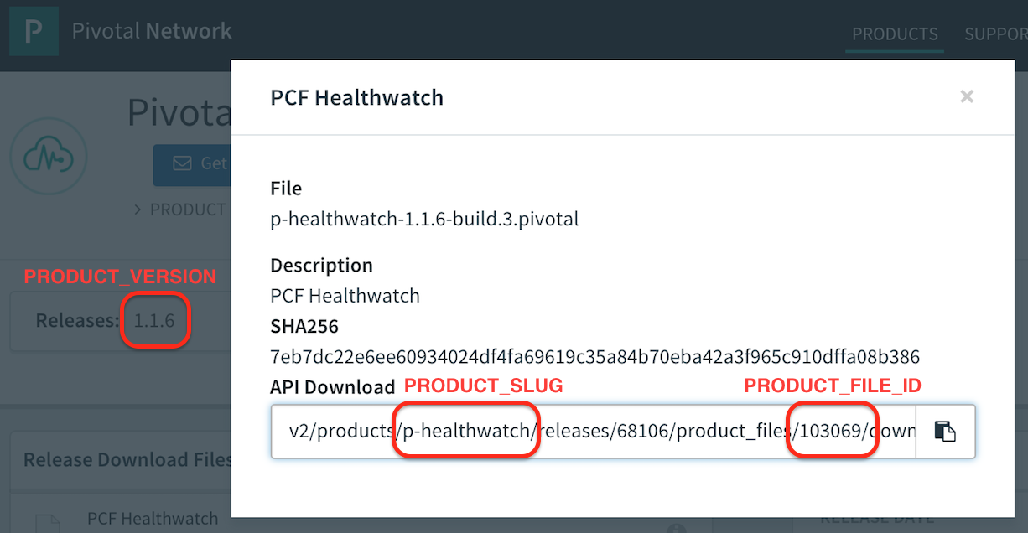
Magic Numbers
Notes:
PRODUCT_SLUG
PRODUCT_VERSION PRODUCT_FILE_ID

Slide 32
Demo
Never Work With Children or Animals …
… or Technology (eeek!)
Notes:
pcf.amcginlay
pcf.springone
pcf.springtwo

Slide 33
Where to next?
Concourse
PCF Pipelines
Dell’s Pivotal Ready Architecture
Your imagination …
Notes:
Fork the repo!

Slide 34

Register Today & Save!
September 24–27, 2018 Washington DC Gaylord, National Harbor
Discount Code
Attendee_CFSummit_100

Slide 35
You Have Been Watching
Alan McGinlay – Pivotal
Email: amcginlay@pivotal.io
Twitter: @amcginlay
LinkedIn: /in/amcginlay
See You Soon!

